Slide 1

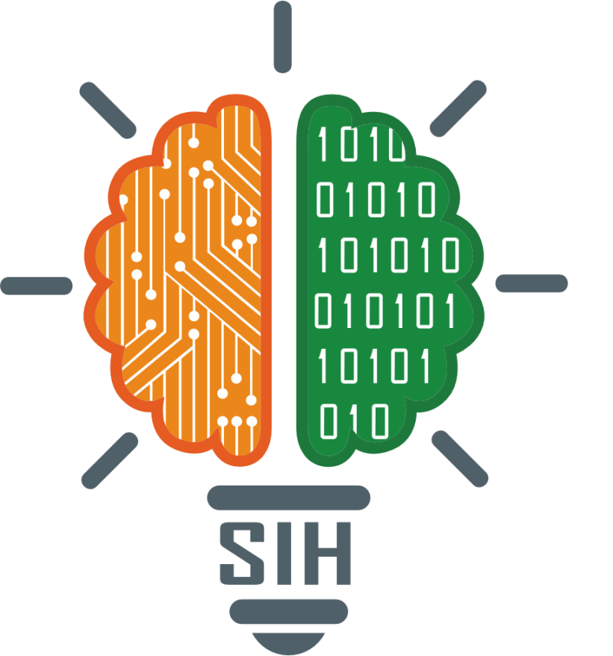
SMART INDIA HACKATHON 2025
TITLE PAGE
Problem Statement ID –25092
Problem Statement Title-Healhub-
Theme-HealthTech
PS Category-Software
Team ID-188
Team Name (Registered on portal)-VertexWave
“Blending technology with care for student wellbeing”

Slide 2

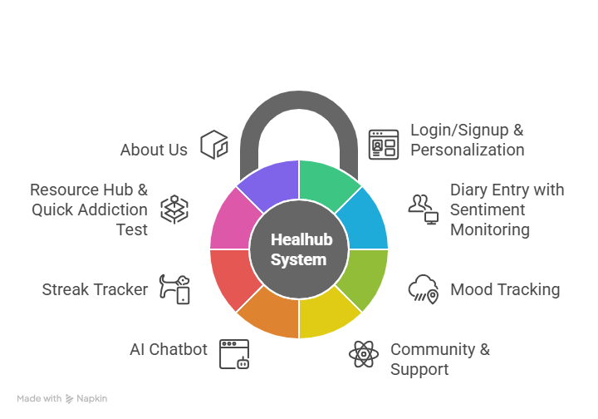
Proposed Solution
Vertex
Wave
Login/Signup & Personalization → Secure access with a personalized experience.
Diary Entry with Sentiment Monitoring → Daily reflections, harmful sentiment detection, and weekly mood analysis with insights.
Mood Tracking → Emotion slider to log and track long-term emotional trends.
Community & Support →Book your appointment with mentors and have counselling sessions for self-improvement.
AI Chatbot → 24/7 guidance and instant feedback.
Streak Tracker → Encourages consistency in self-care activities.
Resource Hub & Quick Addiction Test → Stress
relief through ambient sounds and games, plus fast self-assessment with instant feedback.

Slide 3
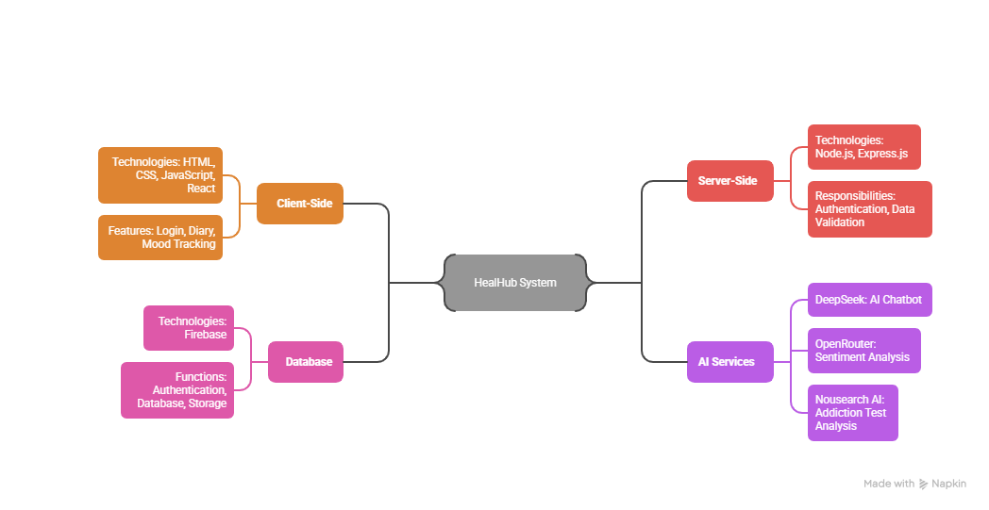
TECHNICAL APPROACH
Vertex
Wave
Frontend: HTML, CSS, JavaScript, ReactJS
Backend: Node.js, Express.js
Database: Firebase (cloud-based, real-time storage and authentication)
AI Models: DeepSeek (sentiment analysis), Nous Research (NLP for chatbot and insights)

Slide 4
FEASIBILITY AND VIABILITY
Vertex
Wave
FEASIBIITY OF THE IDEA:-
💻 Technical: Core buildable with GPT-4, Firebase, React Native; advanced (mentor booking)- needs funding.
⚙️ Operational: Mentor/therapist partnerships viable.
📈 Market: Post-COVID boom; demand for all-in-one, stigma-free mental health solutions.
✨ Differentiators: Sentiment tracking, addiction test, mentor access.
💵 Economic: Lean MVP via open-source; revenue from subscriptions, premium counseling, partnerships..
🚨 Major Risks & Solutions:-
Data Privacy → Risk of leaks → ✅ Encrypt, anonymize, ensure HIPAA/GDPR compliance.
AI Accuracy → Misread harmful emotions → ✅ Hybrid AI + human review, crisis support links.
User Retention → Drop-off after excitement → ✅ Gamification, personalized insights, mentor/community support.
⭐ Supporting Facts for Feasibility and Viability ⭐
A May 2022 IMARC survey found 61% of women and 55% of men in India use digital tools for mental well-being. The Indian mental health app market is projected to grow from $498M (2024) to $1.41B by 2030, CAGR 18.5%.

Slide 5
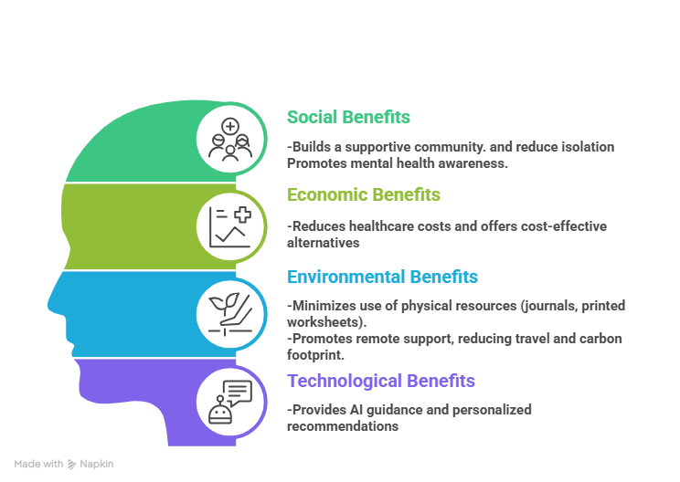
IMPACT AND BENEFITS
Vertex
Wave
Potential Impact
Enhanced Mental Health Awareness: Users gain insights into their emotions, mood patterns, and mental well-being through diary entries, mood tracking, and sentiment monitoring.
Early Detection of Harmful Emotions: Harmful sentiments are identified early, helping prevent escalation of mental health issues.
Access to Support and Guidance: Mentorship, counseling sessions, and a 24/7 AI chatbot provide emotional support and guidance anytime.
Encouragement of Positive Habits: Streak tracking, gamified self-care activities, and resource hubs motivate consistent engagement and personal growth.
Self-Empowerment: Users make informed decisions about their mental health and develop emotional resilience.

Slide 6
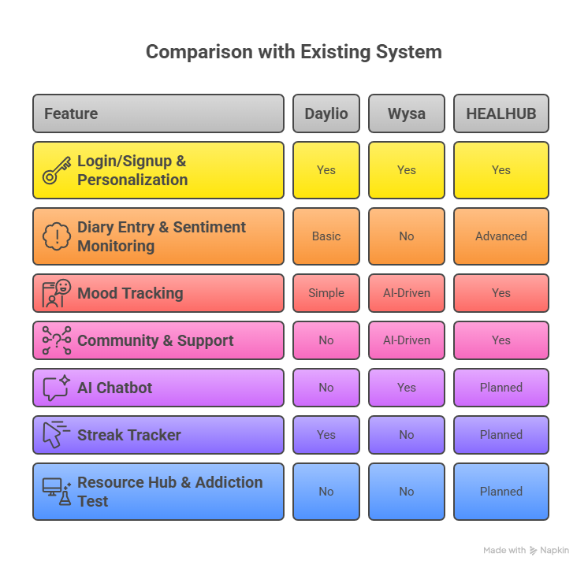
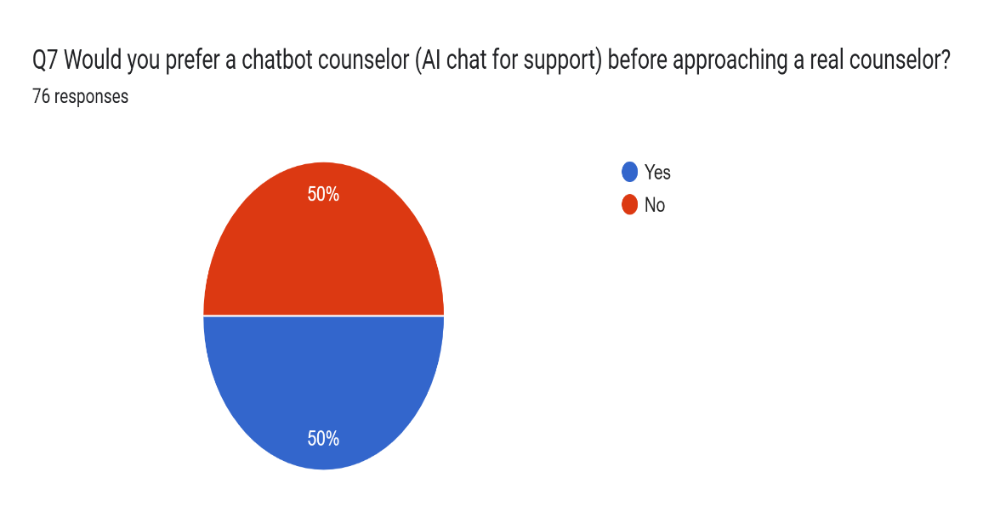
RESEARCH AND REFERENCES
Vertex
Wave
"Artificial Intelligence-Enabled Chatbots in Mental Health: A Systematic Review"
Authors: Batyrkhan Omarov, Sergazi Narynov, Zhandos Zhumanov
Published: August 2025
Source: Computers, Materials & Continua
DOI: 10.32604/cmc.2023.034655
A survey was conducted among first-year students to gather insights on-

